Slide 1
Exception Handling & Multithreaded Programming Unit - IV

Slide 2
Exception Handling Fundamentals
Exception:
“An abnormal condition that arises in a code sequence at run time”.
An exception is a run-time error.
A Java Exception is an object that describes an exceptional condition that has occurred in a piece of code.

Slide 3
Exception Handling Fundamentals
When an exceptional condition arises, an object representing that exception is created and thrown in the method that caused the error
The exception is caught and processed

Slide 4
Exception Types
Catches User prg. exceptions
Exception not expected
to be caught under normal circumstances
Allows Customizing own exceptions
Throwable
Exception
Error
RuntimeException
Default Handler

Slide 5
Uncaught Exception
Exceptions
Java Run-Time System
Manual
Violate the rules of the Java language – syntax errors
Violate the constraints of the Java execution environment – semantic errors
Report some error condition to the caller of a method

Slide 6
Using try, catch & finally
try, catch, throw, throws, finally – keywords
try Block
try
{
}
Program statements
requires monitor for exceptions

Slide 7
Using try, catch & finally
catch Block
catch( ExceptionType1 exObj )
{
}
Program statements
handles for ExceptionType1

Slide 8
Using try, catch & finally
finally Block
finally
{
}
Executed after a try/catch block
Execute if no catch statement matches the exception.

Slide 9
Using try, catch & finally
General form of an exception-handling block:
try {
// block of code to monitor for errors
}
catch (ExceptionType1 exOb) {
// exception handler for ExceptionType1
}
catch (ExceptionType2 exOb) {
// exception handler for ExceptionType2
}
// ...
finally {
// block of code to be executed after try block ends
}

Slide 10
Using try & catch
public static void main(String args[ ]) {
try{
int d = 0;
int a = 30 / d;
}
Arithmetic Exception
throws
catch(ArithmeticException e )
{
}
System.out.println("Division by zero.");

Slide 11
Exception Handling
Displaying a Description of an Exception
Throwable overrides the toString( ) method (defined by Object)
It returns a string containing a description of the exception, can display in a println( )
catch (ArithmeticException e)
{
System.out.println("Exception: " + e);
}
Exception: java.lang.ArithmeticException: / by zero

Slide 12
finally
NOTE:
finally block is always associates with a try
finally block will be executed upon conclusion of the try

Slide 13
Exception Handling
Benefits of using User Defined Exception
Handler:
Allows user to fix the error of our own way
Prevents program from automatic termination

Slide 14
Multiple Catch Clauses
public static void main(String args[ ]) {
try{
int d = 0,ar[ ]={10};
int a = 30 / d;
ar[2]=a;
}
Arithmetic Exception
ArrayIndex
Out OfBoundsException
throws
throws
catch(ArithmeticException e )
{
}
System.out.println("Division by zero.");
catch(ArrayIndexOutOfBoundsException e )
{
}
System.out.println(“Referring Invalid Array index ");

Slide 15
Final Catch Clause
Arithmetic Exception
public static void main(String args[]) {
try{
int d = 0,ar[]={10};
int a = 30 / d;
ar[2]=a;
}
ArrayIndex
Out OfBoundsException
throws
throws
catch(ArithmeticException e )
{
}
System.out.println("Division by zero.");
finally
{
}
System.out.println(“Caught by default block");

Slide 16
Nested try
try
{
} catch() { }
try
{
} catch(){ }
ArrayOutOf
BoundsException
Arithmetic Exception
throw
throw

Slide 17
Throw
Instead of catching Exceptions of Java Run-time system, user can throw an exception explicitly in program by using the keyword throw.
Syntax:
throw ThrowableInstance;
throw new ThrowableInstance;
ThrowableInstance must be an object of type Throwable class or a subclass of Throwable.

Slide 18
Throw
Two ways to obtain a Throwable object:
Using a parameter in a catch clause
Creating one with the new operator
Usage1:
catch(Exception eobj)
{ //use of ebj }
Usage2:
try
{ throw new ExceptionType(“user msg"); }

Slide 19
Throw - interpretations
NOTE:
The flow of execution stops immediately after the throw statement
Any subsequent statements are not executed
try block is inspected to see if it has a catch statement that matches the type of the exception

Slide 20
Throw - interpretations
If finds a match, control is transferred to that statement.
If not, then the next enclosing try statement is inspected, and so on.
If no matching catch is found, then the default exception handler halts the program and prints the stack trace.

Slide 21
Throws
To give information regarding the behavior of a method to the callers, so that caller can guard themselves against that particular kind of exceptions
throws clause
Lists the types of exceptions that a method might
throw
type method-name(parameter-list) throws exception-list
{
// body of method
}

Slide 22
Java’s Built-in Exceptions
Standard package java.lang defines several exception classes
These exceptions are subclasses of the standard type RuntimeException
Types of Exceptions
Checked Exceptions
Unchecked Exceptions

Slide 23
Exception Types
Allows to create own exceptions
Throwable
Not implements anything
Exception
Error
RuntimeException
PredefinedSubclassException

Slide 24
Built-in Exceptions – Checked Exceptions
Java expects all types of exceptions to be listed in throws clause of any method that handles exceptions
Unchecked Exceptions are the exceptions compiler does not check to see if a method handles or throws these exceptions
15 different unchecked exceptions are there in JDK 8

Slide 25
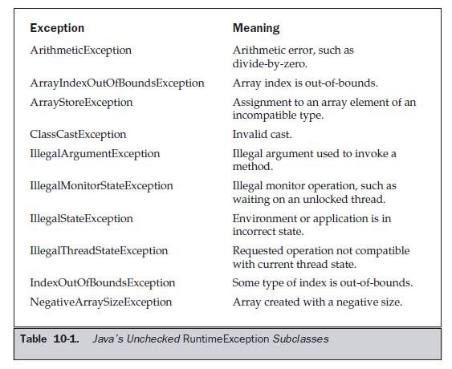
Built-in Exceptions – Unchecked Exceptions

Slide 26
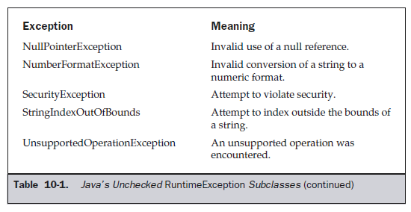
Built-in Exceptions – Unchecked Exceptions

Slide 27
Java’s Built-in Exceptions
Checked Exceptions are the exception types must be included in a method’s throws clause list, if that method can generate one of these exceptions and does not handle it itself
8 different checked exceptions are there in
JDK 8

Slide 28
Built-in Exceptions – Checked Exceptions

Slide 29
Exception Types
Allows to create own exceptions
Throwable
Not implements anything
Exception
Error
UserDefinedSubclassException
RuntimeException
PredefinedSubclassException

Slide 30
Creating Own Exception Subclasses
To create our own exception types to handle situations specific to our applications
Define our exception classes as subclass of Exception
Exception class does not define any methods of its own, just inherits from Throwable
Even our subclass nothing to implement

Slide 31
Creating Own Exception Subclasses
Existence of our exception type, allows us to use them as exceptions
Exception defines four public constructors
Exception( )
Exception(String msg)

Slide 32
Throwable class methods

Slide 33
Throwable class methods

Slide 34
Chained Exceptions
Exception that associates one exception within another
Second exception describes the cause of the first exception
To support chained exceptions Throwable class contains following constructors and methods:
Throwable(Throwable causeExc)
Throwable(String msg, Throwable causeExc)
Throwable getCause( )
Throwable initCause(Throwable causeExc)

Slide 35
Introduction – Threads
Multitasking:
“Simultaneous Execution of multiple programs”
In system’s terminology multitasking is known as Multithreading
Types of Multitasking:
Process Based Multitasking
Thread Based Multitasking

Slide 36
Introduction – Threads
1. Process Based Multitasking:
“ A feature of multitasking that allows the computer to run two or more programs concurrently ”.
Process
“ A program under execution”.
Example:
javac, text editor, Browsing together
concurrently

Slide 37
Introduction – Threads
NOTE:
In process-based multitasking, a program is the smallest unit of code that can be dispatched by the scheduler

Slide 38
Introduction – Threads
2. Thread Based Multitasking:
“A single program is performing two or more tasks / parts simultaneously”.
Thread
“It is similar to a program that has a single flow of control”. (Beginning, Body, End)
Example:
Text Editor which can perform format on text at the same time that it is printing

Slide 39
Introduction – Threads
NOTE:
The thread is the smallest unit of
dispatchable code.

Slide 40
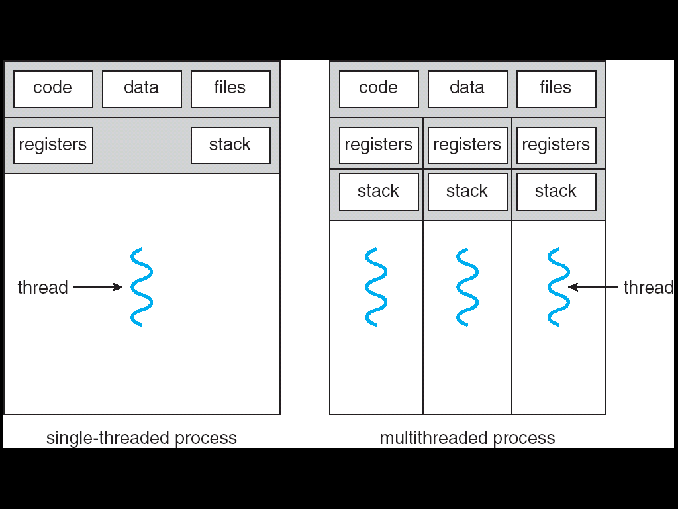
Introduction – Threads

Slide 41
Processes Threads
Heavy weight tasks. Light weight tasks.
Requires separate Shares the same
address spaces. address space.
Interprocess comm. Inexpensive &
Is expensive & limited. Unlimited.
Context switching is Easily Switches with
Costly. low cost

Slide 42
Introduction – Threads
Multithreading:
“Is a conceptual programming paradigm where a program(process) is divided into two or more parts / subprograms (child processes), which can run in parallel”.

Slide 43
Introduction – Threads
In Java Terminology:
Thread:
“Single flow of control performs single task”.
Multithreading Programming:
“Is a programming paradigm where a single program contains multiple flows of control, each performing separate task”.

Slide 44
Introduction – Threads
NOTE:
“Threads running in parallel” does not really that they actually run at the same time. Since all the threads are running on a single processor , the flow of execution is shared b/n threads. The Java Interpreter handles the switching of control b/n in such a way that it appears they are running Concurrently.

Slide 45
Advantages of Multithreading
Makes maximum use of the CPU to keep its idle time minimum.
Prevents waste of CPU cycles.
Enables programmer to do multiple things at one time.
Improves speed of programs.

Slide 46
Traditional Programming
class ExThread
{
public static void main( String [ ] arg)
{
----------------
----------------
----------------
----------------
----------------
----------------
----------------
----------------
}
}

Slide 47
Multithreading Programming
Main Thread
----------------
----------------
----------------
----------------
start
start
start
Thread A
----------------
----------------
----------------
----------------
Thread B
----------------
----------------
----------------
----------------
Thread C
----------------
----------------
----------------
----------------
switches
switches

Slide 48
The Java Thread Model
Single-threaded systems use an approach called an event loop with polling
Java’s multithreading is that the main loop/polling mechanism is eliminated
One thread can be paused without stopping other parts of the program

Slide 49
Thread states (Life Cycle of a Thread)
New Thread
NewBorn
start( )
stop( )
run( )
Running
Runnable
stop( )
Dead
Active
Thread
yield( )
stop( )
suspend( )
sleep( )
wait( )
resume( )
notify( )
Idle Thread
(Not Runnable)
Blocked

Slide 50
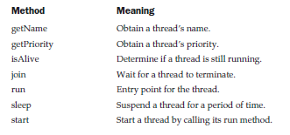
Threads

Slide 51
Creating a Thread
To adopt multithreaded programming paradigm, threads are to be created and utilized in the program
Threads can be created by:
Creating an object of Thread class
Implementing Runnable interface

Slide 52
Extending Thread Class
class ExThread extends Thread
{
public void run()
{ }
}
Constructor of the Thread class
Thread(Runnable threadOb, String threadName)
Other methods
Mandatory

Slide 53
Implementing Runnable Interface
class ExThread implements Runnable
{
public void run()
{ }
}
Thread(Runnable threadOb, String threadName)
The only method to override is run()
Mandatory

Slide 54
Creating a Thread
Runnable or Thread?
Thread class
To override other methods along with run( )
Must to implement run( )
When no other class to extend
Runnable interface
Only to implement run( )
When other class to extend

Slide 55
Thread Priorities
Used by the Thread scheduler to decide which thread should be allowed to run.
Higher – priority threads gets more CPU time than the Lower – priority threads.
Threads of Equal – priority should get equal access to the CPU.
Methods to set / get a thread’s priority:
final void setPriority(int level)
final int getPriority( )

Slide 56
Thread Priorities
Level can have - MIN_PRIORITY (1)
MAX_PRIORITY (10)
NORM_PRIORITY (5)
Default Priority is NORM_PRIORITY (5)
These priorities are defined as final variables within Thread class.

Slide 57
Synchronization
Thread Based Synchronization:
“The process in which two or more threads are monitored to check whether only one thread is using the shared resource at a time”.
Tools to handle Synchronization:
Semaphore, Monitor or Mutex

Slide 58
Concurrent Access to Shared Data
Suppose that two processes A and B have access to a shared variable “Balance”:
PROCESS A:
Balance = Balance – 100
PROCESS B:
Balance = Balance – 200

Slide 59
PROCESS A
The statement “ Balance = Balance – 100” is
implemented by several machine level instructions as
A1. LOAD R1, BALANCE
A2. SUB R1, 100
A3. STORE BALANCE, R1

Slide 60
PROCESS B
Similarly, “Balance = Balance – 200” can be
implemented as :
B1. LOAD R1, BALANCE
B2. SUB R1, 200
B3. STORE BALANCE, R1

Slide 61
Race Conditions
In a time-shared or multi-processing system the exact instruction execution order cannot be predicted. . .!
Scenario 1
A1. LOAD R1, BALANCE
A2. SUB R1, 100
A3. STORE BALANCE, R1
Context Switch!
B1. LOAD R1, BALANCE
B2. SUB R1, 200
B3. STORE BALANCE, R1
Scenario 2
A1. LOAD R1, BALANCE
A2. SUB R1, 100
Context Switch!
B1. LOAD R1, BALANCE
B2. SUB R1, 200
B3. STORE BALANCE, R1
Context Switch!
A3. STORE BALANCE, R1
Balance is effectively decreased
by 300!
Balance is effectively decreased
by 100!

Slide 62
Synchronization
Synchronization of code done in two ways
- using Synchronized Methods
- using Synchronized Statement

Slide 63
Using Synchronized Methods
class SharedCode
{
synchronized void service( )
{
---------------
---------------
---------------
}
}

Slide 64
Using Synchronized Statement
Before calling the service method we make the thread itself to synchronized.
synchronized(object)
{
// statements to be synchronized
}

Slide 65
End of Unit - 4

